Slide 1
Process Scheduling
The process scheduling is the activity of the process manager that handles the removal of the running process from the CPU and the selection of another process on the basis of a particular strategy.
The prime aim of the process scheduling system is to keep the CPU busy all the time and to deliver minimum response time for all programs.
The objective of multiprogramming is to have some process running at all times, to maximize CPU utilization.

Slide 2
The objective of time sharing is to switch the CPU among processes so frequently that users can interact with each program while it is running.
To meet these objectives, the process scheduler selects an available process (possibly from a set of several available processes) for program execution on the CPU.
For a single processor system, there will never be more than one running process.
If there are more processes, the rest will have to wait until the CPU is free and can be rescheduled.

Slide 3
What are Scheduling Queues?
The Job Queue stores all processes that are entered into the system.
The Ready Queue holds processes in the ready state.
Device Queues hold processes that are waiting for any device to become available. For each I/O device, there are separate device queues.
The ready queue is where a new process is initially placed. It sits in the ready queue, waiting to be chosen for execution or dispatched. One of the following occurrences can happen once the process has been assigned to the CPU and is running:

Slide 4
The process could send out an I/O request before being placed in the I/O queue.
The procedure could start a new one and then wait for it to finish.
As a result of an interrupt, the process could be forcibly removed from the CPU and returned to the ready queue.
In the first two cases, the process eventually switches from the waiting state to the ready state, and is then put back in the ready queue. A process continues this cycle until it terminates, at which time it is removed from all queues and has its PCB and resources deallocated.

Slide 5
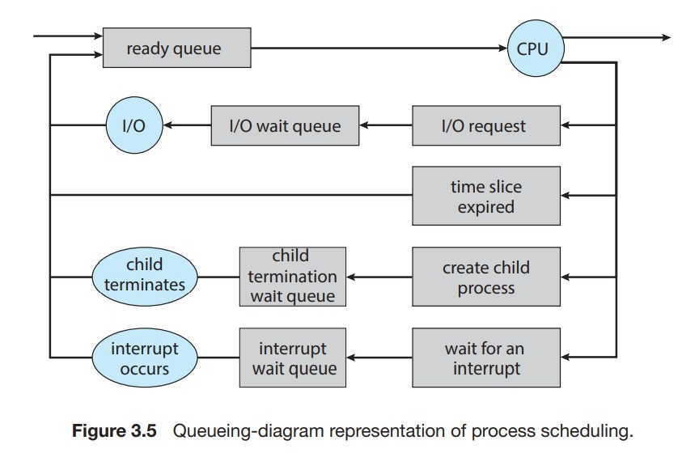

Slide 6
Types of Schedulers
There are three types of schedulers available:
Long Term Scheduler
Short Term Scheduler
Medium Term Scheduler

Slide 7
Long Term Scheduler
Job scheduler is another name for it.
A long-term scheduler determines which programs are accepted for processing into the system.
It picks processes from the queue and then loads them into memory so they can be executed.
For CPU scheduling, a process loads into memory.

Slide 8
Short Term Scheduler
CPU scheduler is another name for it.
Its major goal is to improve system performance according to the set of criteria defined.
It refers to the transition from the process’s ready state to the running stage.
The CPU scheduler happens to choose a process from those that are ready to run and then allocates the CPU to it.

Slide 9
Medium Term Scheduler
This scheduler removes the processes from memory (and from active contention for the CPU), and thus reduces the degree of multiprogramming.
At some later time, the process can be reintroduced into memory and its execution can be continued where it left off.
This scheme is called swapping.
The process is swapped out, and is later swapped in, by the medium term scheduler.
Swapping may be necessary to improve the process mix, or because a change in memory requirements has overcommitted available memory, requiring memory to be freed up.
This complete process is descripted in the below diagram:

Slide 10
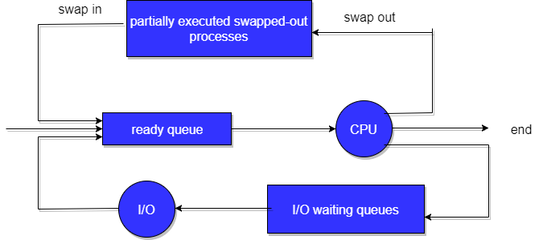
Addition of Medium-term scheduling to the queueing diagram

Slide 11
Context Switch
Switching the CPU to another process requires saving the state of the old process and loading the saved state for the new process. This task is known as a Context Switch.
The context of a process is represented in the Process Control Block(PCB) of a process; it includes the value of the CPU registers, the process state and memory-management information.
When a context switch occurs, the Kernel saves the context of the old process in its PCB and loads the saved context of the new process scheduled to run.

Slide 12
3.Context switch time is pure overhead, because the system does no useful work while switching.
Its speed varies from machine to machine, depending on the memory speed, the number of registers that must be copied, and the existence of special instructions(such as a single instruction to load or store all registers).
Typical speeds range from 1 to 1000 microseconds.
4.Context Switching has become such a performance bottleneck that programmers are using new structures(threads) to avoid it whenever and wherever possible.

Slide 13
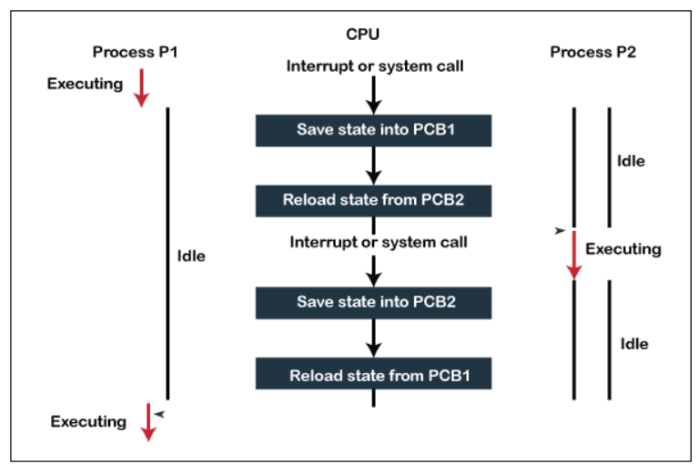

Slide 14
1. Preemptive Scheduling:
Preemptive scheduling is used when a process switches from running state to ready state or from the waiting state to ready state.
The resources (mainly CPU cycles) are allocated to the process for a limited amount of time and then taken away, and the process is again placed back in the ready queue if that process still has CPU burst time remaining.
That process stays in the ready queue till it gets its next chance to execute.
Algorithms based on preemptive scheduling are: Round Robin (RR),Shortest Remaining Time First (SRTF), Priority (preemptive version), etc.

Slide 15
2. Non-Preemptive Scheduling:
Non-preemptive Scheduling is used when a process terminates, or a process switches from running to the waiting state.
In this scheduling, once the resources (CPU cycles) are allocated to a process, the process holds the CPU till it gets terminated or reaches a waiting state.
In the case of non-preemptive scheduling does not interrupt a process running CPU in the middle of the execution.
Instead, it waits till the process completes its CPU burst time, and then it can allocate the CPU to another process.
Algorithms based on non-preemptive scheduling are: Shortest Job First (SJF basically non preemptive) and Priority (non preemptive version), etc.

Slide 16
Dispatcher
The dispatcher is done after the scheduler.
It gives control of the CPU to the process selected by the short-term scheduler.
After selecting the process, the dispatcher gives CPU to it.
Functions
Switching context.
Switching to user mode.
Jumping to the proper location in the user program to reboot that program
Managing dispatch latency (time consumed by dispatcher is referred as dispatch latency)

Slide 17
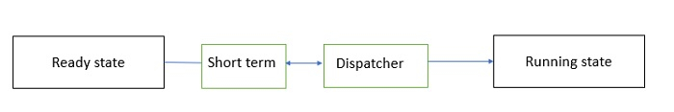
Fig. Dispatcher

Slide 18
For example,
Suppose there are 5 processes P1, P2, P3, P4, and P5.
The arrival times of these processes are T1, T2, T3, T4, and T5.
Here, FIFO (first in first out) algorithm is used. So, P1 comes first, and then the scheduler will choose that it is the first process that is going to execute.
The dispatcher will eliminate P1 from ready queue and take it to the CPU.
Now, the scheduler will select P2, which will be executed after P1.
The dispatcher removes P2 from the ready queue and gives it to the CPU.
This carries on in a similar way for processes P3, P4, and P5.
This is how a dispatcher works.
The scheduler provides the dispatcher with an ordered list of processes that the dispatcher gives to the CPU.
The dispatcher does many tasks such as memory mapping, context switching and setting up user registers.

Slide 19
Scheduling Criteria
The criteria include the following:
CPU utilization: We want to keep the CPU as busy as possible. Conceptually, CPU utilization can range from 0 to 100 percent. In a real system, it should range from 40 percent (for a lightly loaded system) to 90 percent (for a heavily loaded system). (CPU utilization can be obtained by using the top command on Linux, macOS, and UNIX systems.)
Throughput: If the CPU is busy executing processes, then work is being done. One measure of work is the number of processes that are completed per time unit, called throughput. For long processes, this rate may be one process over several seconds; for short transactions, it may be tens of processes per second.

Slide 20
Turnaround time: From the point of view of a particular process, the important criterion is how long it takes to execute that process. The interval from the time of submission of a process to the time of completion is the turnaround time. Turnaround time is the sum of the periods spent waiting in the ready queue, executing on the CPU, and doing I/O.
Waiting time: The CPU-scheduling algorithm does not affect the amount of time during which a process executes or does I/O. It affects only the amount of time that a process spends waiting in the ready queue. Waiting time is the sum of the periods spent waiting in the ready queue.

Slide 21
Response time: In an interactive system, turnaround time may not be the best criterion. Often, a process can produce some output fairly early and can continue computing new results while previous results are being output to the user. Thus, another measure is the time from the submission of a request until the first response is produced. This measure, called response time, is the time it takes to start responding, not the time it takes to output the response.

